Slide 1
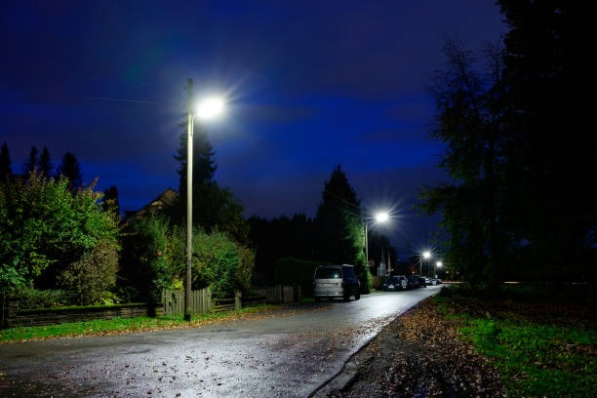

FINDING THE SHORTEST PATH PREVENTING SEXUAL HARASSMENT THROUGH ALGORITHMS

Slide 2
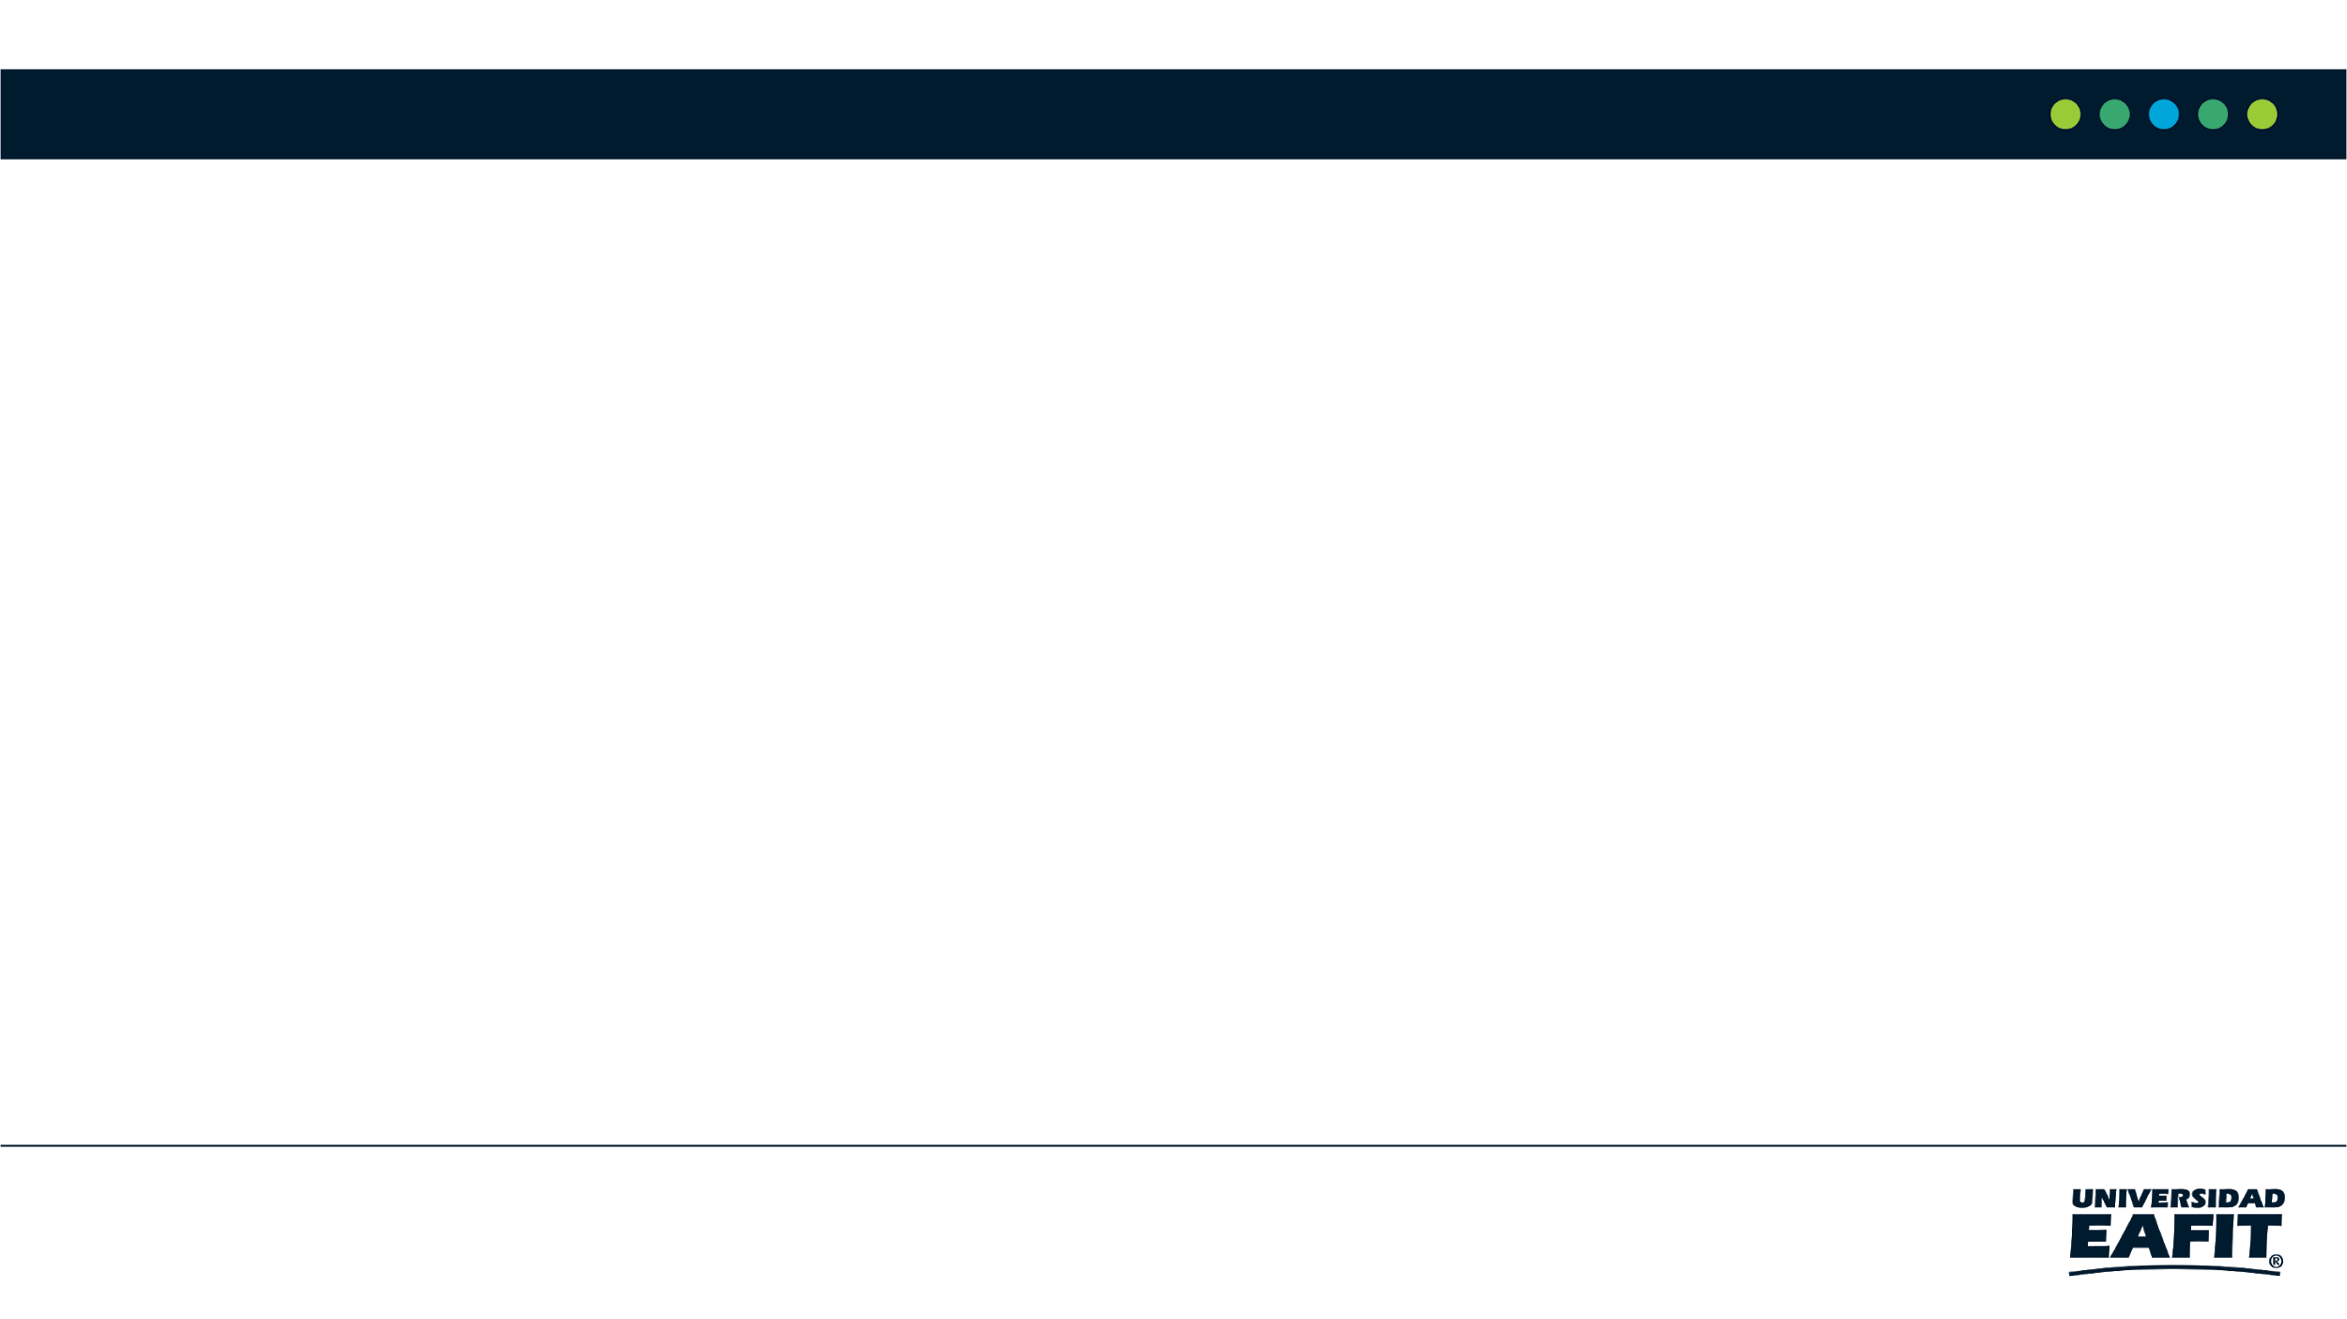



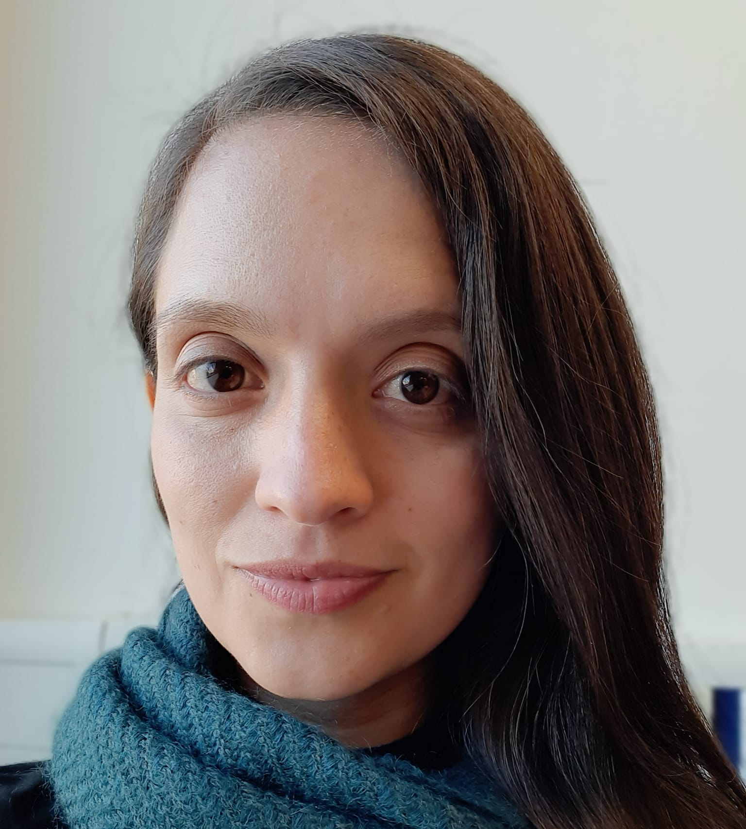

Presentation of the team
Juan Felipe Restrepo
Author
Sara Valentina Cortes
Author
Andrea Serna
Literature review
Mauricio Toro
Data preparation
https://github.com/JuanFelipeRestrepoBuitrago/ST0245

Slide 3
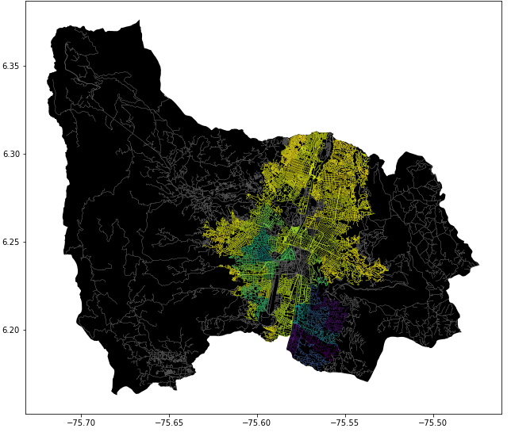
Problem Statement
Shortest path algorithm
Streets
of Medellín, Origin and Destination
Three paths that reduce both the risk of harassment and distance

Slide 4
Solution Algorithm
Dijkstra Algorithm
Streets
of Medellín, Origin and Destination
A path that reduces both distance and harassment

Slide 5
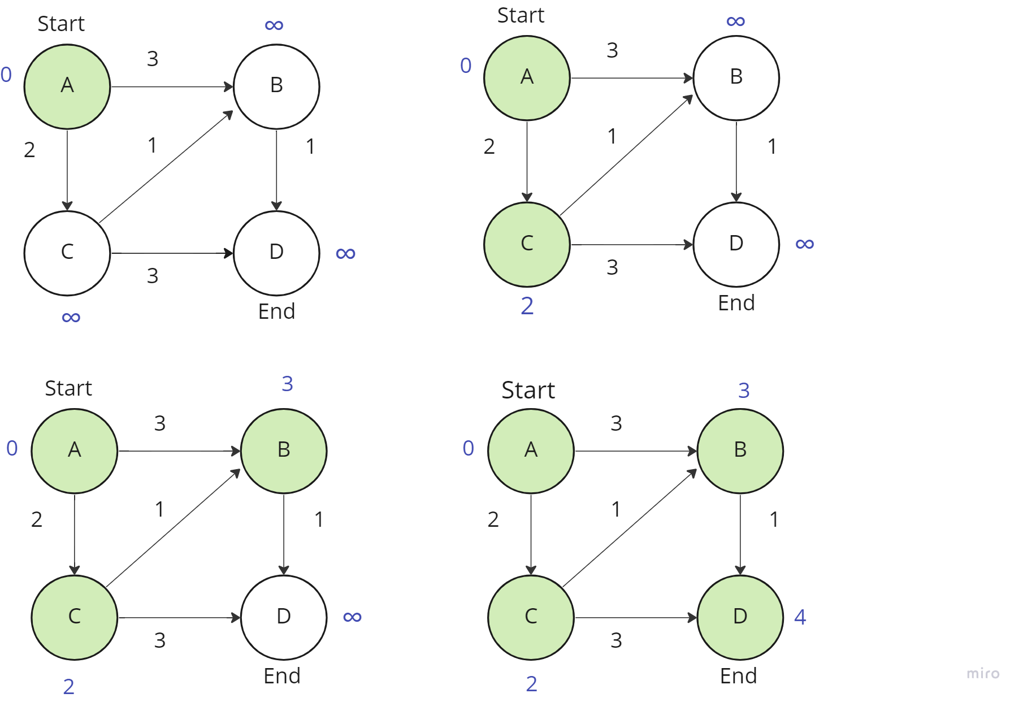

Explanation of the algorithm
Dijkstra Algorithm for the Shortest Path

Slide 6
Complexity of the algorithm
 | Time complexity | Complexity of memory
Dijkstra | O((V+E) Log V) | O(V)
Time and memory complexity of the algorithm name. V is the vertex of the graph and E the edges

Slide 7
First path minimizing distance
Origin | Destination | Distance (meters) | Risk of harassment (between 0 and 1)
EAFIT University | National University | 7686.62 | 0.71
Distance and risk of harassment for the path that minimizes distance. Execution time of 0,14 seconds.

Slide 8
Second path minimizing harassment risk = d^r
Origin | Destination | Distance (meters) | Risk of harassment (between 0 and 1)
EAFIT University | National University | 11027.69 | 0.47
Distance and risk of harassment for the path that minimizes r = d^r . Execution time of 0,15 seconds.

Slide 9
Third path minimizing distance and harassment risk = d + r / 2
Origin | Destination | Distance (meters) | Risk of harassment (between 0 and 1)
EAFIT University | National University | 7762.26 | 0.72
Distance and risk of harassment for the path that minimizes distance and harassment risk. Execution time of 0,19 seconds.

Slide 10
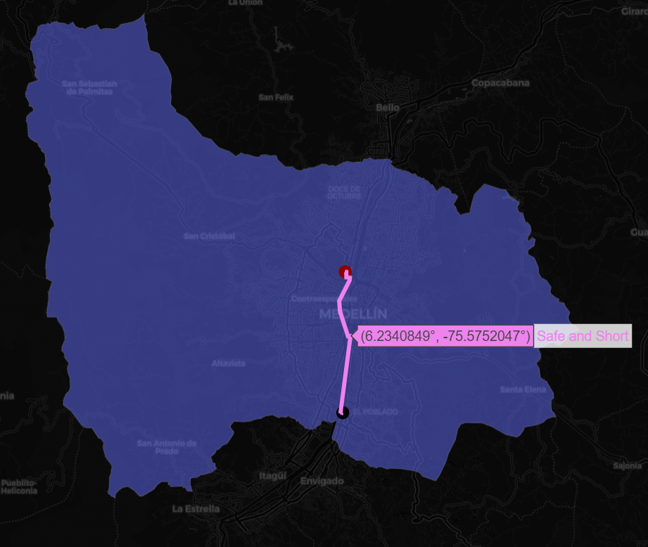
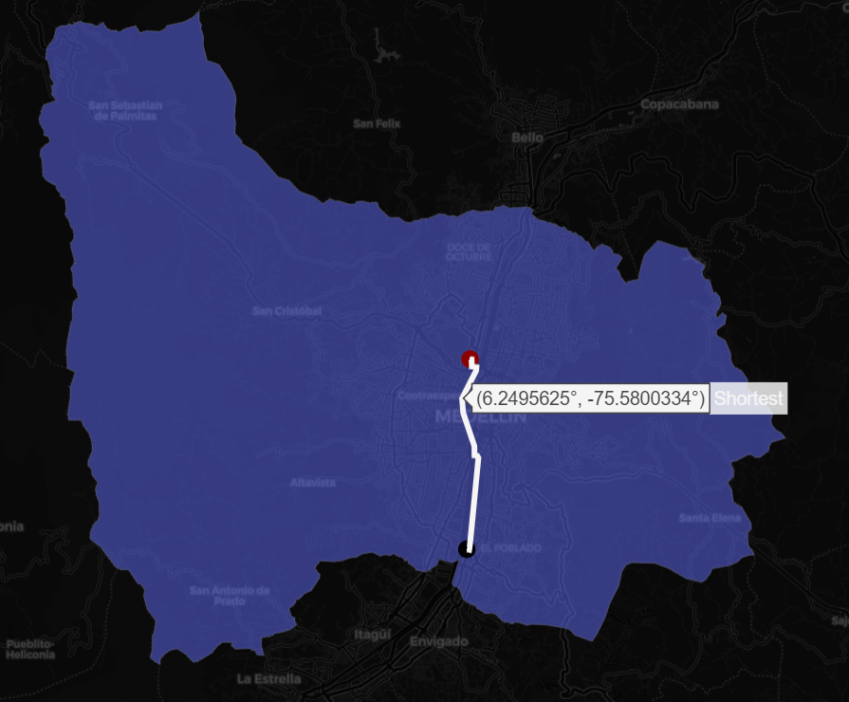
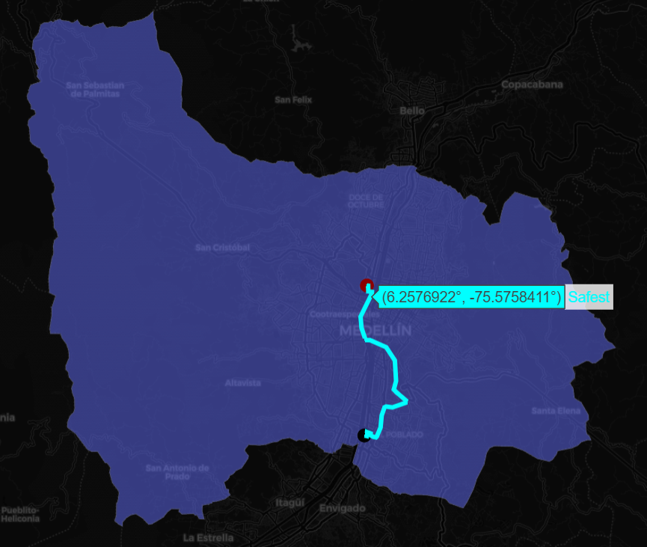
Visual comparison of the three paths

Slide 11

Future work directions
Please name the courses in which you could continue to work on this project.
Optimization 1
Statistics 2
M & S 4
Optimization Bi target
MV risk estimates
Traffic Estimation
Please tell us what you could do, in the following courses, to improve this project.

Slide 12
Future work directions
Databases
Project 1
Software Engineering
Project 2
Other variables
Web application
Mobile application
Include ML or VR
Please tell us what you could do, in the following courses, to improve this project.
You can add, delete or change some future work addresses

Slide 13
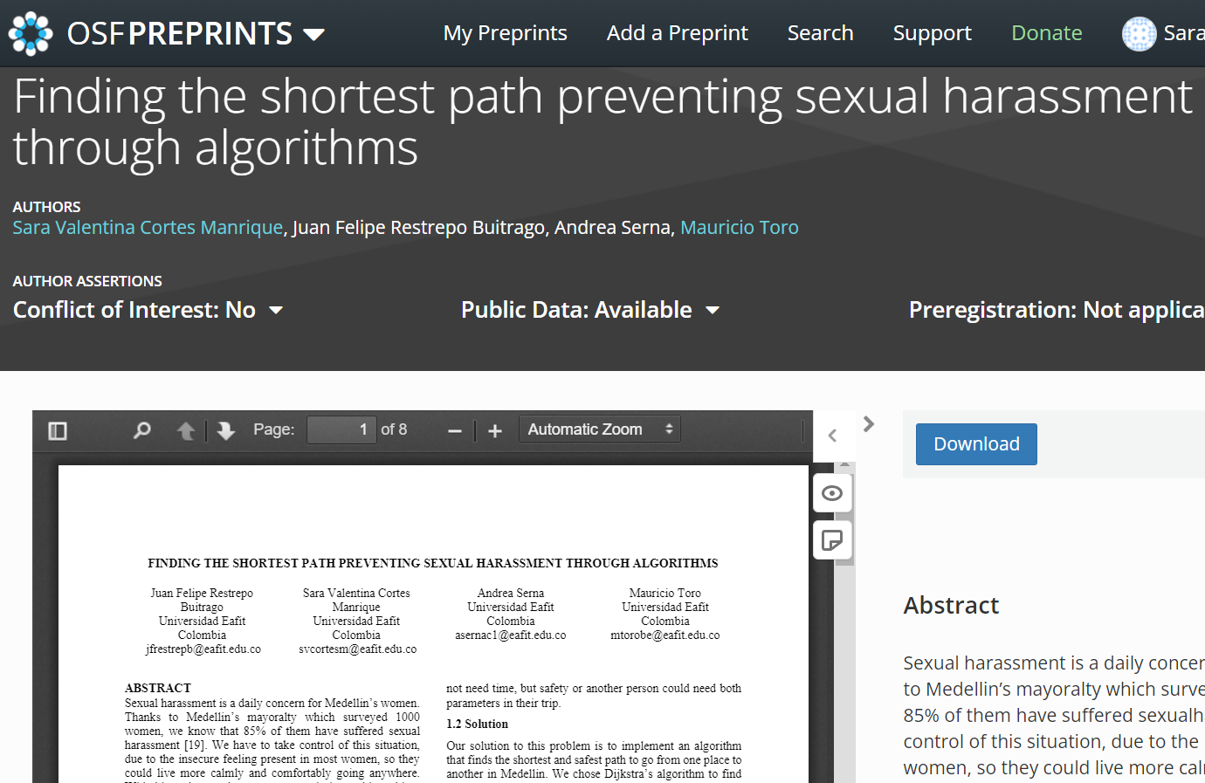
Report accepted in OSF.IO
Sara V C Manrique, Juan F R Buitrago, Andrea Serna, and Mauricio Toro. 2022. Finding the shortest path preventing sexual harassment through algorithms. Retrieved from osf.io/qtj2c

Slide 14
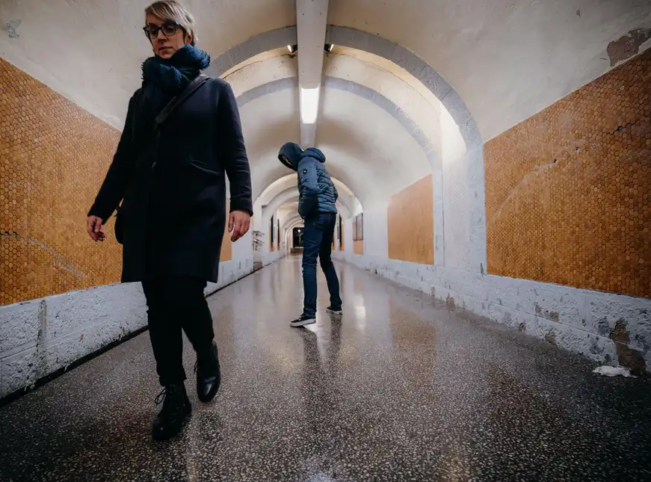
THANK YOU!!!
With the support of
The first two authors were supported by the Sapiencia grant, financed by the municipality of Medellín. All authors are grateful to the Vice Rector's Office for Discovery and Creation, Universidad EAFIT, for their support in this research.

